Slide 1
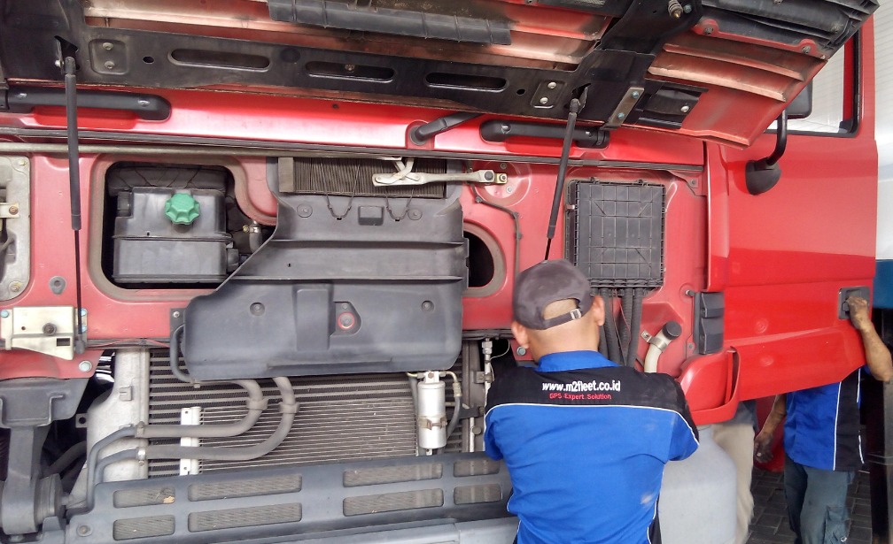

ANALOG OUTPUT FOR FUEL TANK COVER
FUEL COVER WITH M2FLEET
Optimize and improve your business with M2Fleet Solution, By Implementing fuel theft alert and fuel cover tank to prevent fuel theft

Slide 2
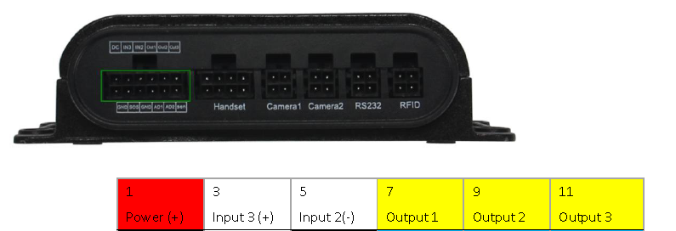
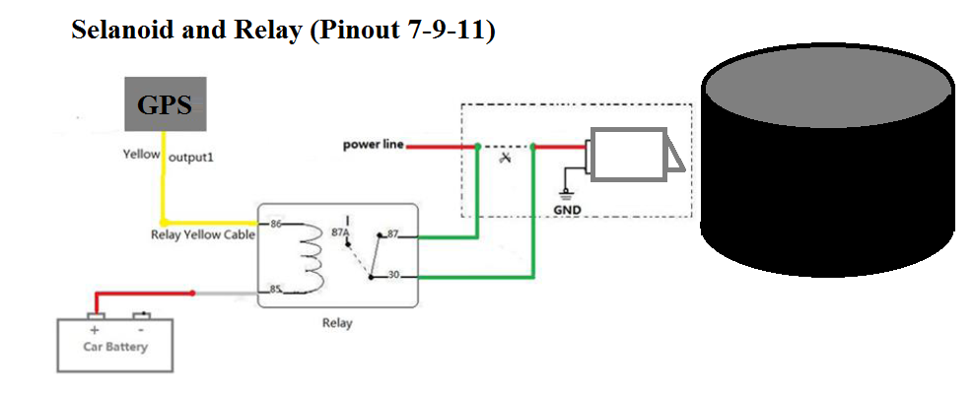
ANALOG OUTPUT in GPS
Connects to an external relay to remotely cut off the vehicle fuel cable or engine power supply or other open-drain
Solenoid, Relay and Door Sensor

Slide 3
Benefit
Preventive Scenario from Fuel Theft
Fuel Cost Efficiency by reducing Fuel Theft
Monitoring Fuel Refill
Fuel Refill Authorization needed
Lock and Unlock Remotely
Command send using Server or SMS
Integrated with current solution (M2Fleet)

Slide 4

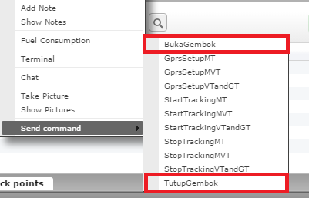
Solution
Optimize and improve your business with M2Fleet Solution, By Implementing fuel theft alert and fuel cover tank to prevent fuel theft
Output Pin in GPS can be implement to any extended business purpose that required open drain technology, in this case we use this feature to implement fuel cover lock and solenoid, we can add new command to GPS to do “BukaGembok” and “TutupGembok”.
When “TutupGembok” command send from server , GPS will instruct or give analog output some data (voltage) , this data will make solenoid locked. And also when we send “BukaGembok”, the operation will open the cover.

Slide 5
THANK YOU
Visit our blog www.blog.m2fleet.co.id

